Slide 1

What is a computer?

Slide 2

What is it really?

Slide 3
Active Learning
How would you explain it?

Slide 4
How would you explain the pattern of eating in a restaurant?

Slide 5

Users
I/O

Slide 6

Messages

Slide 7

Storage
Storage
Storage
RAM

Slide 8

Chef - CPU

Slide 9
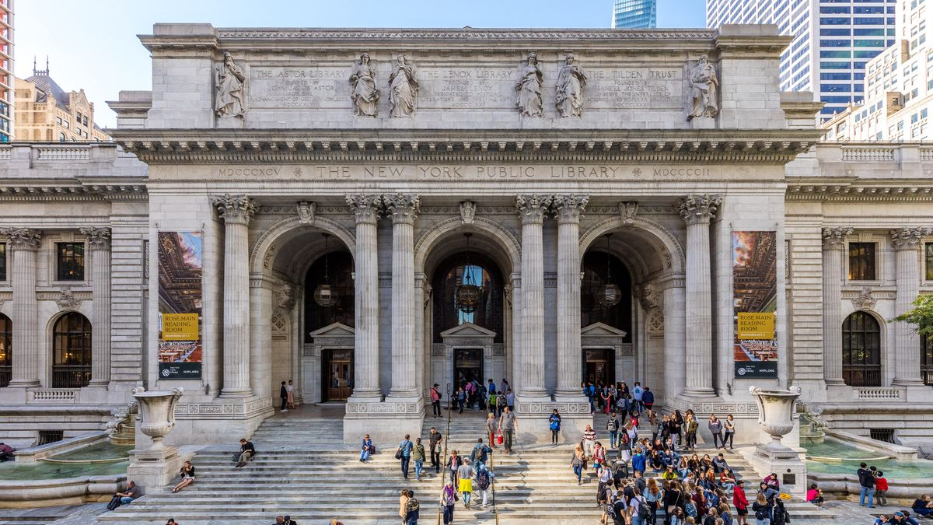

Slide 10


Slide 11
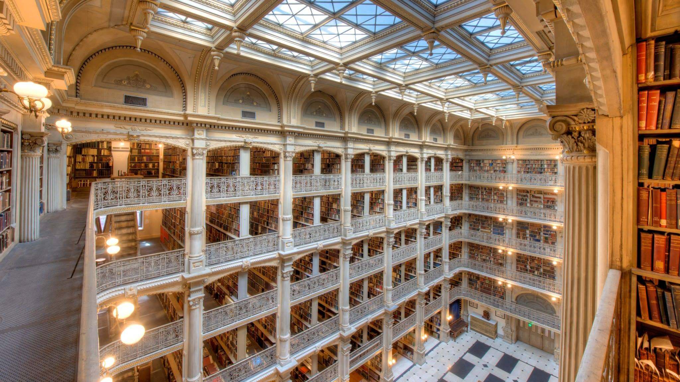

Slide 12


Slide 13


Slide 14


Slide 15
High level description of a computer
The restaurant analogy
Explain that we will write instructions
The computer will interpret them

Slide 16
Topics covered – Code for day is declarative
HTML
CSS
Screen coordinate system
Z-Index
DIV properties

Slide 17


Slide 18
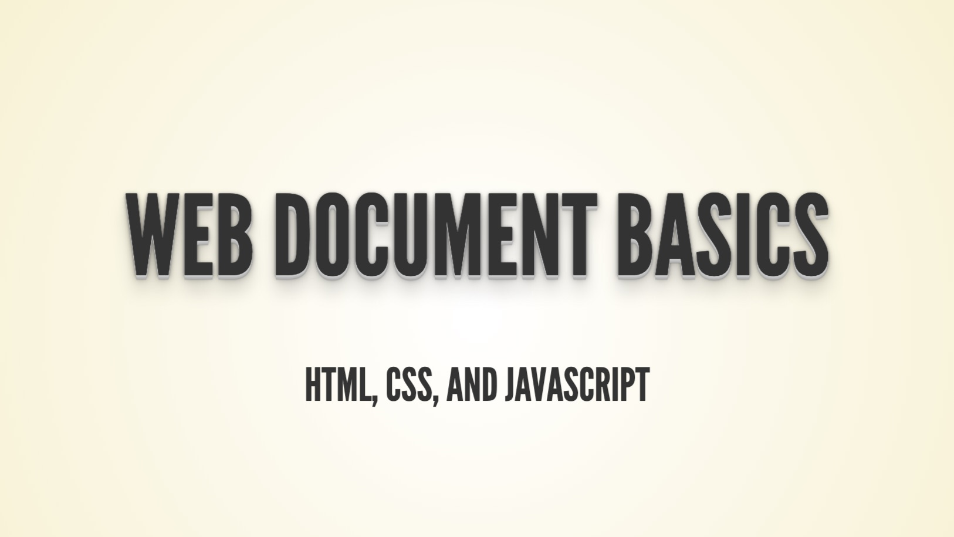

Slide 19
Active learning
Declarative programming
Say ”Hello World!”
Create a simple web document

Slide 20


<div style="
z-index:5;
position:absolute;
left:100px;
top:200px;
width:100px;
height:100px;
border-radius:50%;
background:black">
</div>
<div style="
z-index:5;
position:absolute;
left:100px;
top:200px;
width:100px;
height:100px;
border-radius:50%;
border: 3px solid">
</div>

Slide 21
Active learning
Create a couple of shapes

Slide 22
top: 200
left: 100
height: 100
width: 100
background: black

Slide 23
y
z-index
left: 100
z
x
top: 200

Slide 24
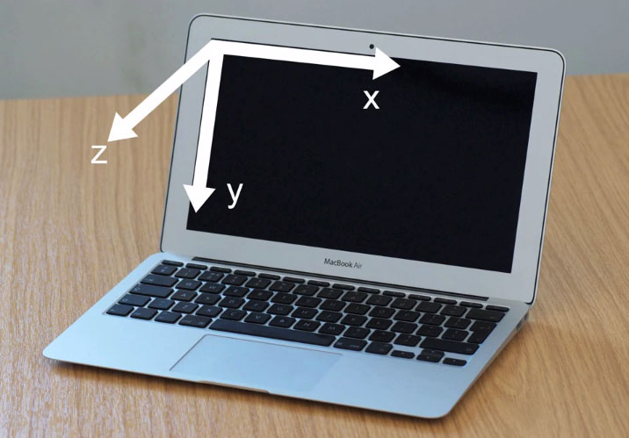
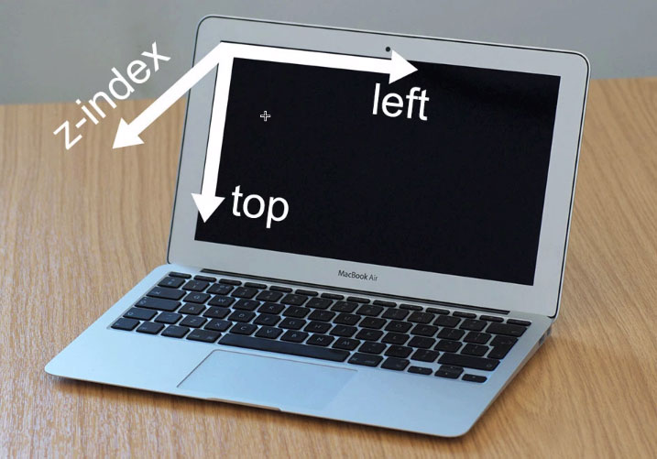
Coordinates

Slide 25


Slide 26
For more colors see:
http://goo.gl/uQVY8f
<div style="
z-index:5;
position:absolute;
left:100px;
top:200px;
width:100px;
height:100px;
border-radius:50%;
background:black">
</div>

Slide 27
Active learning
Create shape

Slide 28



https://css-tricks.com/examples/ShapesOfCSS/

Slide 29


Slide 30


Slide 31


